Slide 1
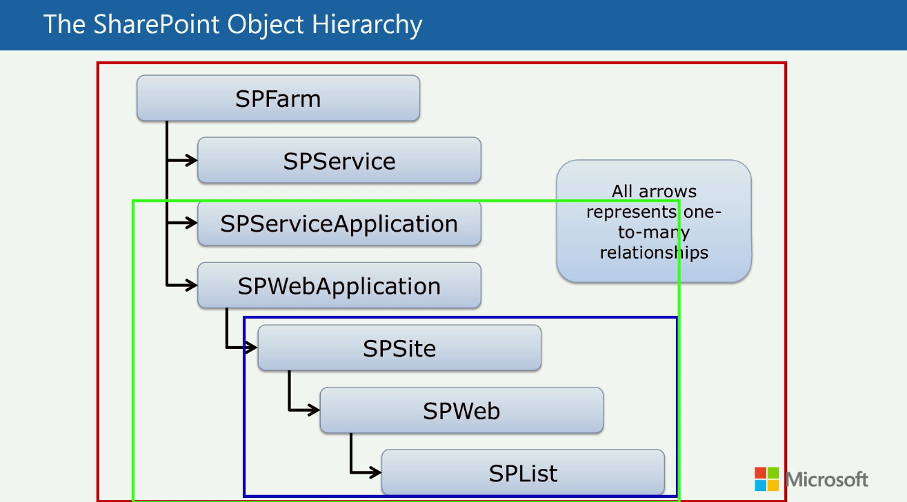
Farm
Apps
Sandbox

